Slide 1


Meal Master
By Andie Perreira & Tamsyn Evezard

Slide 2
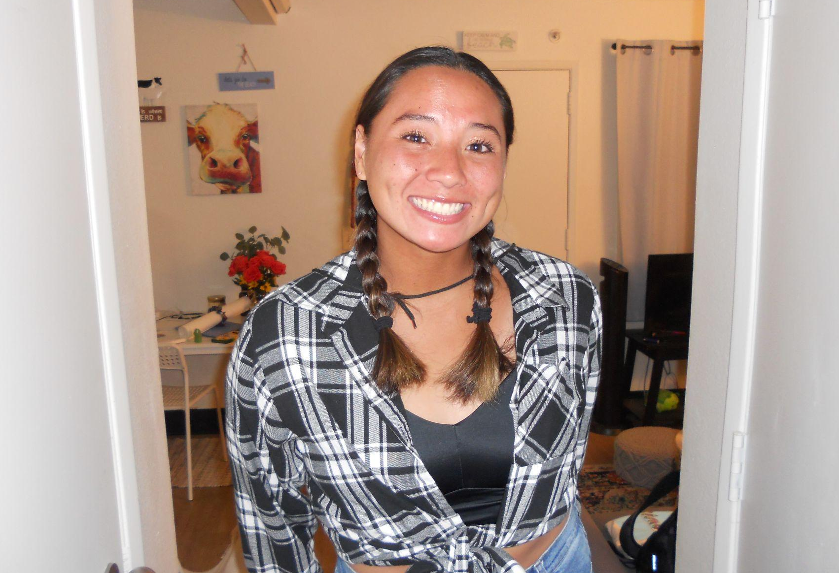

Meet the Team!
Andie Perreira
Tamsyn Evezard
O'ahu, Hawai’i
Port Elizabeth, South Africa

Slide 3
Qualification Station
Computer Science Majors: Seniors
3+ years of programming experience through CUI courses in various programming languages
C#, Python, C, C++, Java, HTML, CSS, JavaScript
Using previous knowledge to learn the ropes of React Native and the coding equivalents
NCAA Division II Athletes - CUI Women’s Water Polo: resilient, driven, adaptable

Slide 4
Why Meal Master…
Athletes: nutrition & meal planning for performance
Coordinating meals, managing recipes, and creating shopping lists = challenging
The market lacks a comprehensive and user-friendly solution that seamlessly unifies these tasks
React is one of the most popular frameworks in development currently - React Native enhances those skills to help in the workforce
We are able to apply our computer science knowledge to real world demands
Allows us to learn new and relevant skills

Slide 5
Meal Master as a React Native Mobile App
In-Demand Skills:
React (React Native) is popular for Front-End Development in job market
Cross-Platform Development:
iOS and Android all at once!
Component-Based Architecture:
Reusable & Maintainable code
Large Community and Resources:
Teaching ourselves through vast resources available online through documentation, tutorials and libraries available
Notes:
There are several reasons why developing a mobile app using React (particularly React Native) makes a good computer science project:
In-demand Skills: React is one of the most popular frameworks for front-end web development, and React Native extends those skills to mobile app development. Learning React equips you with sought-after skills in the job market.
Cross-Platform Development: React Native allows you to build mobile apps for both iOS and Android using a single codebase. This saves time and resources compared to learning separate languages like Java (Android) or Swift (iOS).
Component-Based Architecture: React uses a component-based architecture, which promotes code reusability and maintainability. This makes it easier to build complex UIs and manage your project as it grows.
Large Community and Resources: React has a vast and active community of developers, which means there's plenty of online support, tutorials, and libraries available to help you with your project.
Practical Application: Building a mobile app allows you to apply your computer science knowledge to a real-world scenario. You'll gain experience with user interface design, user experience (UX) principles, and potentially integrating with APIs or data services.
Visible Portfolio Piece: A completed mobile app can be a strong addition to your portfolio, showcasing your development skills and problem-solving abilities to potential employers.
Overall, a React mobile app project allows you to learn valuable, relevant skills, experience practical software development, and create a tangible project to demonstrate your capabilities.

Slide 6
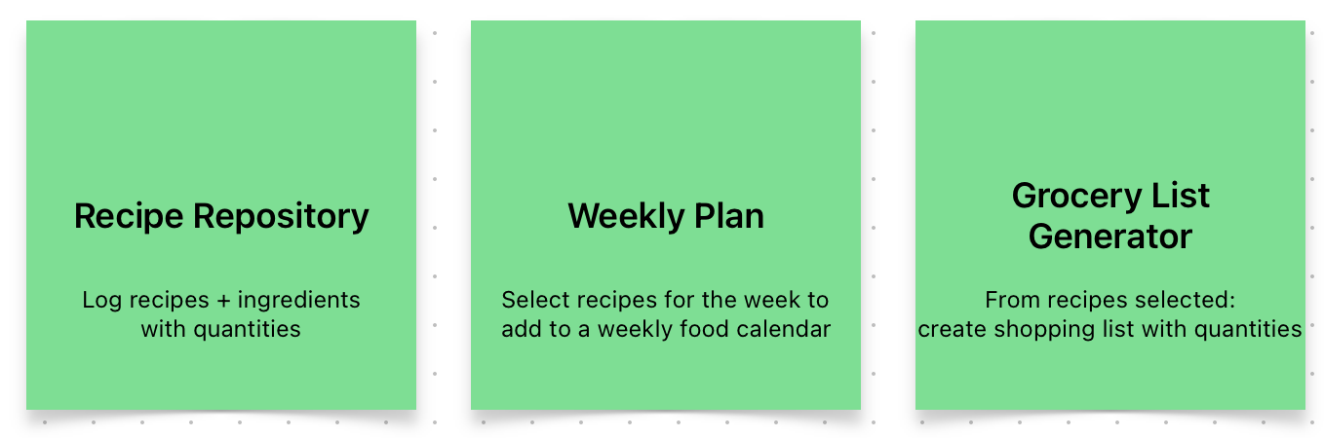
Culinary Harmony Unleashed: Meal Master
Functions
Recipe repository: Log your favorite recipes
Meal planner: Meal plan for the upcoming week
Shopping list organizer: Ensures you have all the ingredients you need with less waste and less planning time

Slide 7
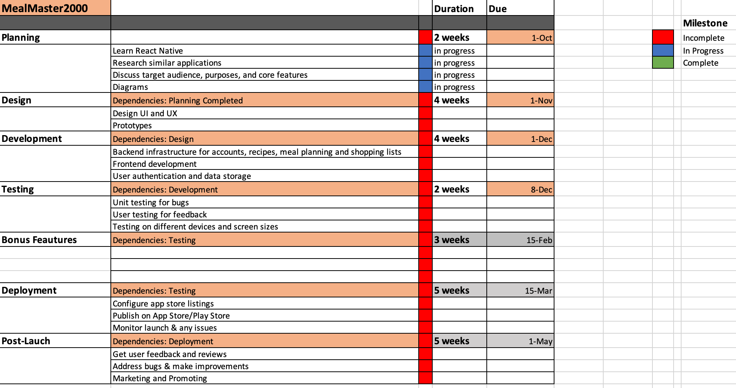
Organization Station

Slide 8
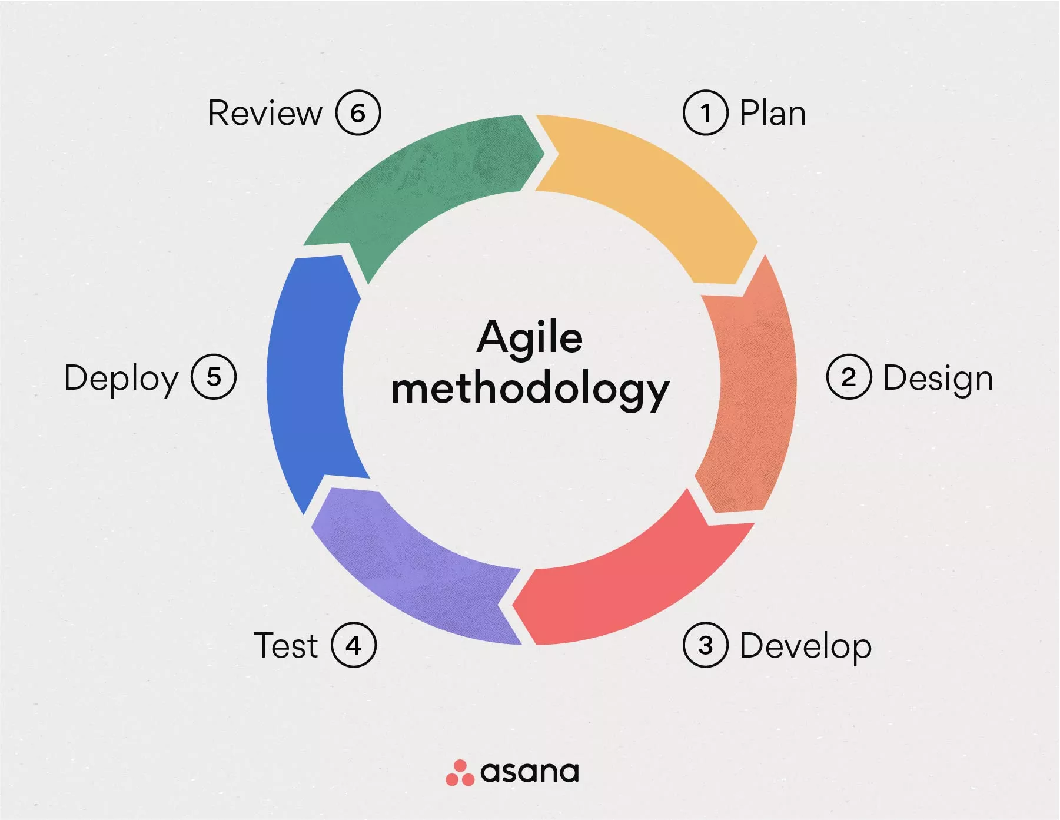
Delectable Design
Final Design Plan

Slide 9
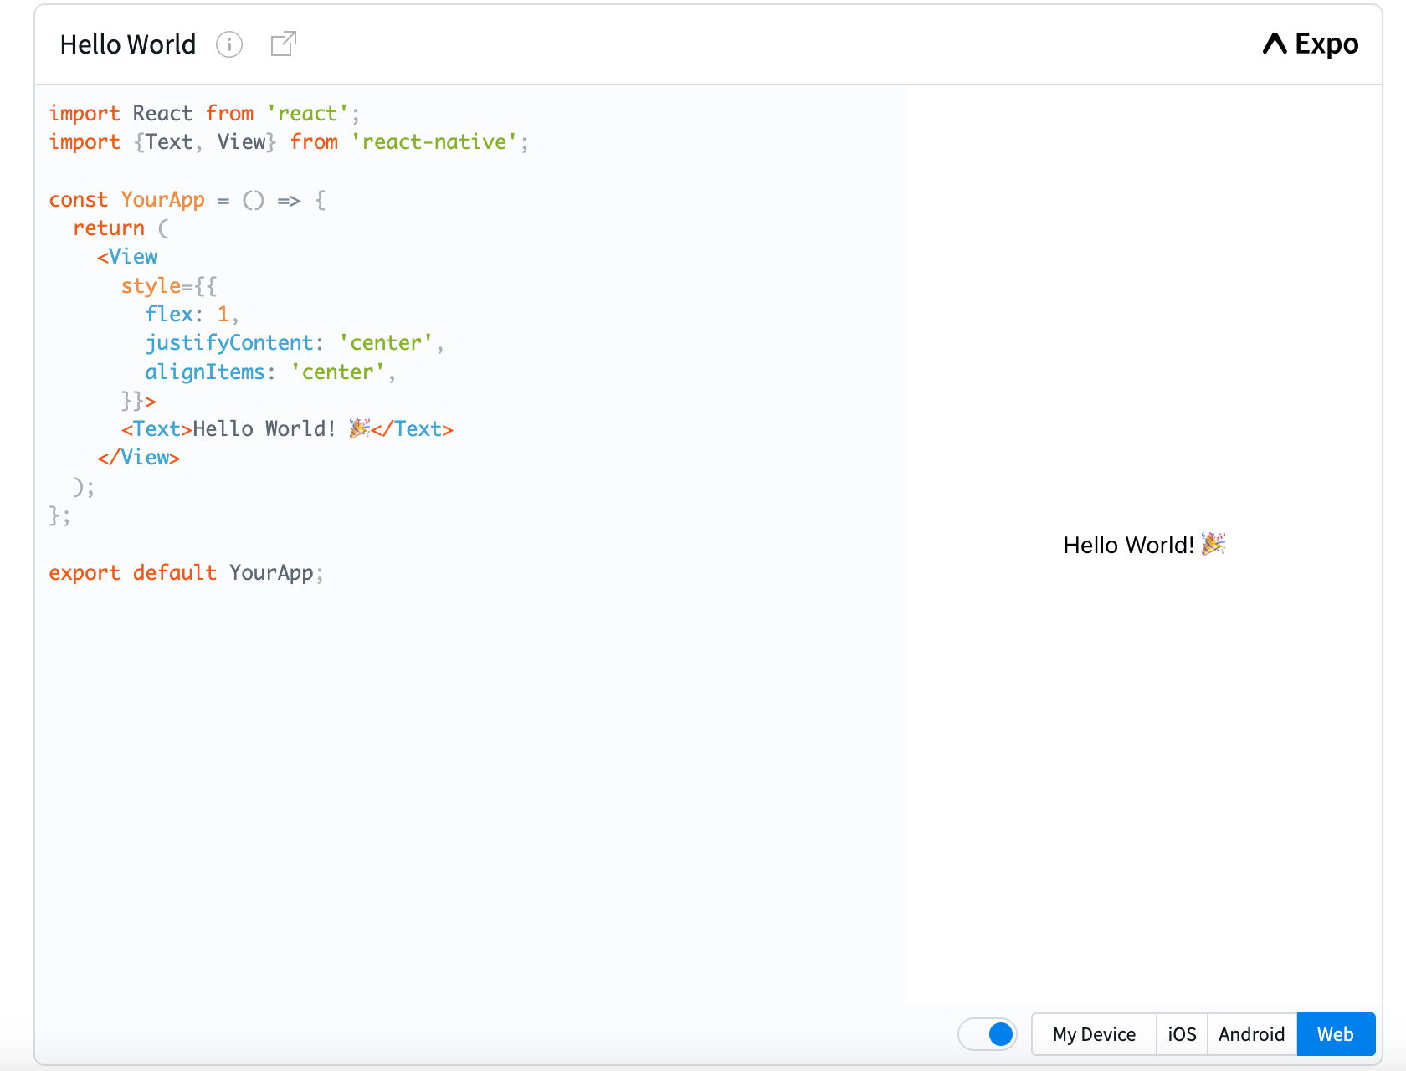

Final Design Plan
Frontend:
React Native
Expo Go
Backend
Secure Store (expo)
Database system (future)
Encryption & authentication (future)

Slide 10
Taste Testing
Testing Plan
Software Testing
Non-Functional Testing
Unit
Integration
System
Sanity
Smoke
Regression
Beta
Performance
Load
Stress
Volume
Security
Install
Usability

Slide 11
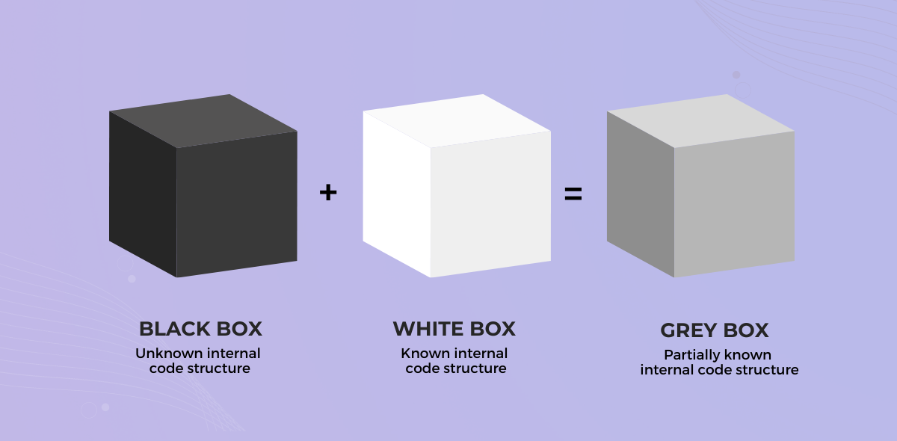
Other testing methods…

Slide 12
Algorithmic Appetizers
Algorithms, object, data
Recipe Search and Retrieval
Meal Planning
Shopping List Generation
User Authentication & Security
Text Search Algorithms
Optimization Algorithms
Graph algorithms
List Generation Algorithms
Sorting Algorithms
Hashing Algorithms
Token-Based Authentication
1
2
3
4
Notes:
A lot of these still to come

Slide 13
Performance Optimization
UI Optimization
Data Storage and Retrieval
Caching Algorithms
Layout Algorithms
UI Rendering Optimization
Database Indexing
Data Compression
5
6
7

Slide 14


Culinary Challenges
New resources
React Native & Expo Go
Little experience in creating a mobile application

Slide 15
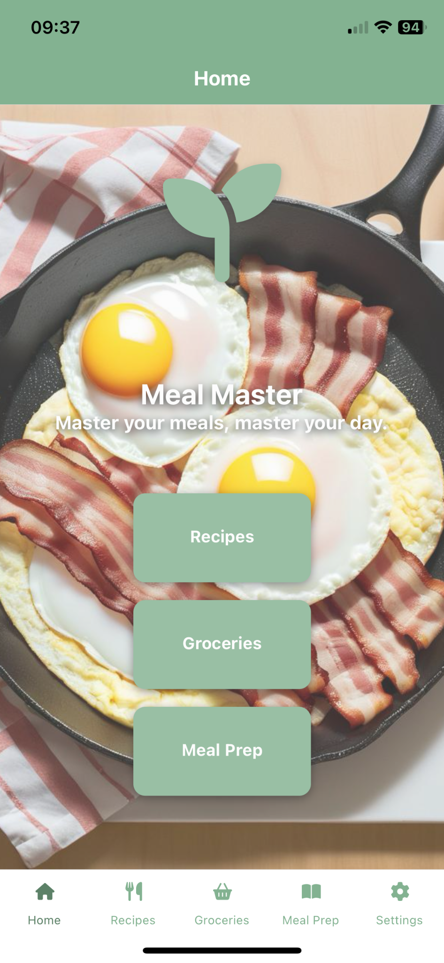
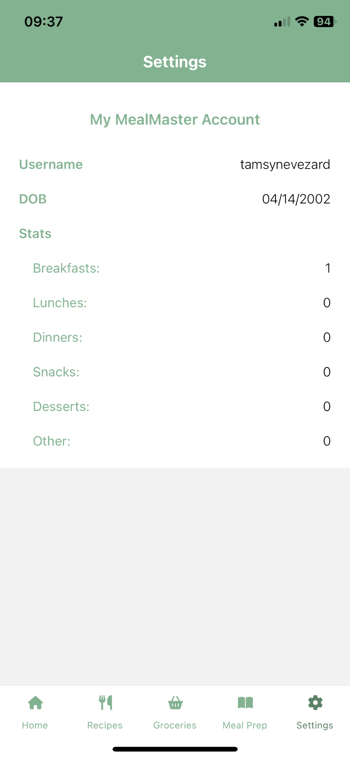
Prototype
Demo
Meal Master App

Slide 16
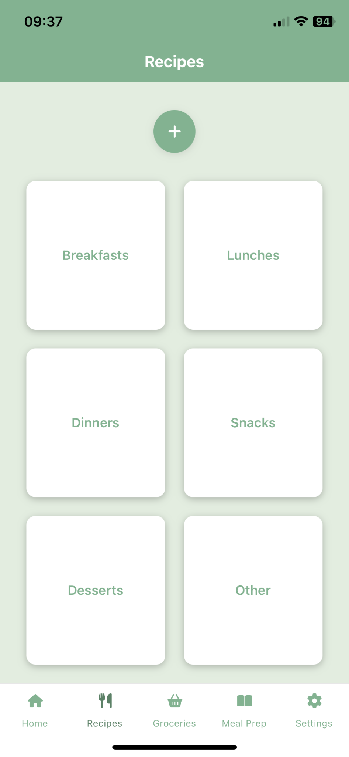
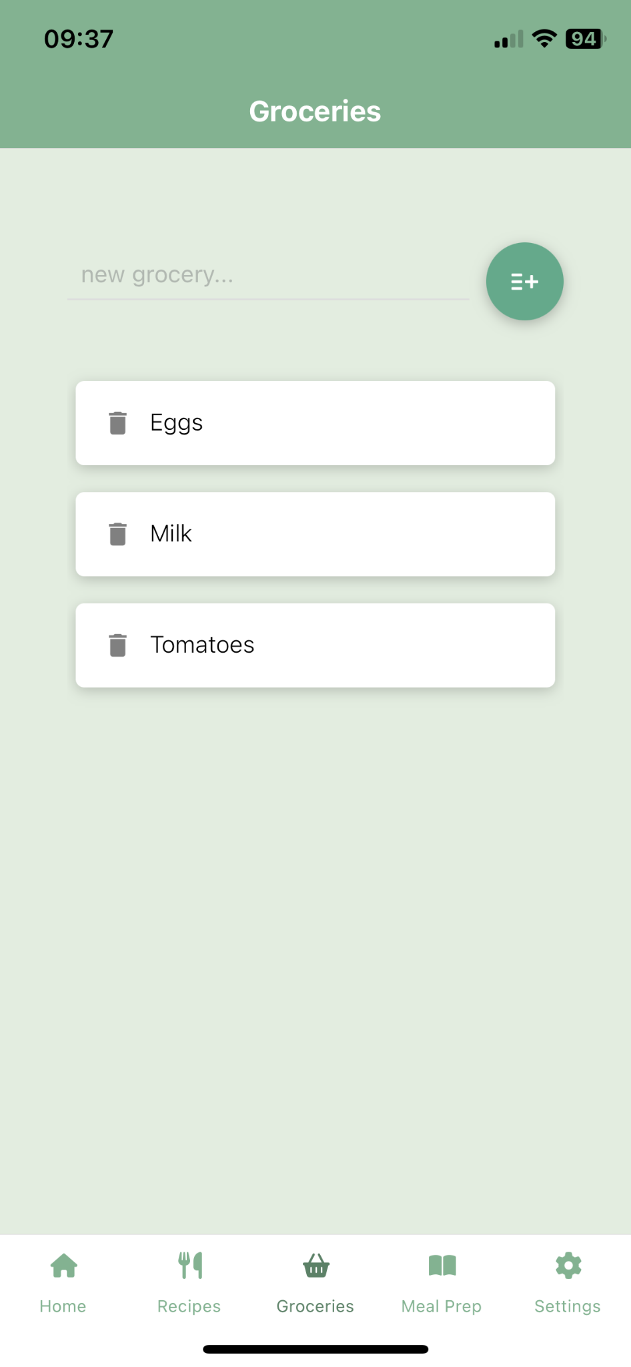
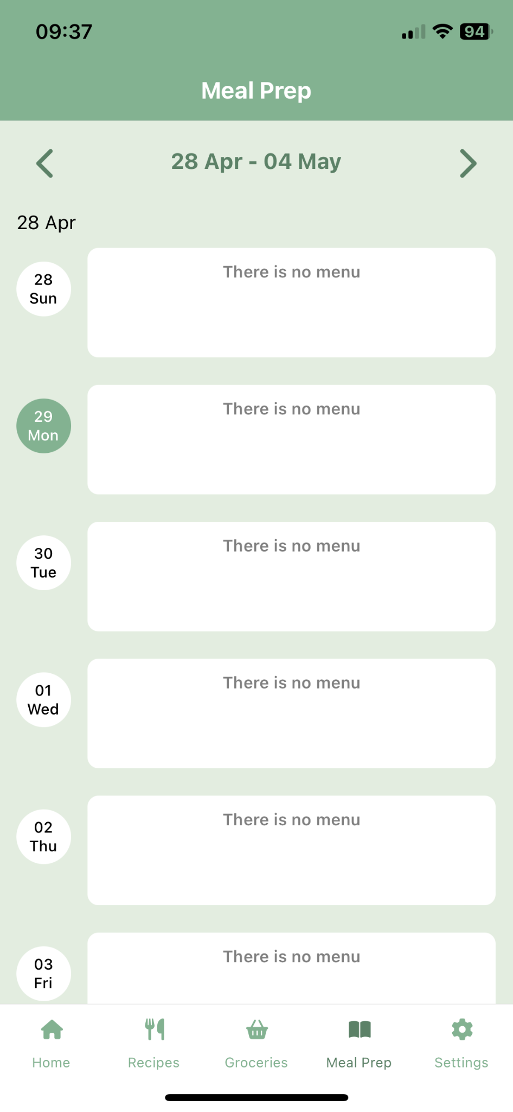
Notes:
TABS

Slide 17
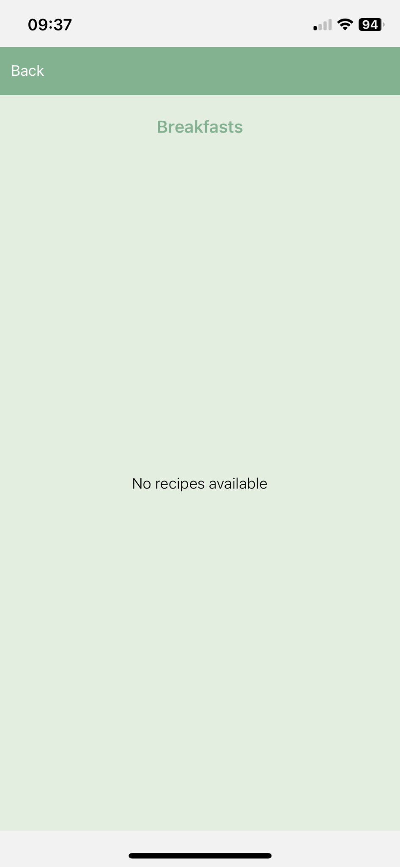
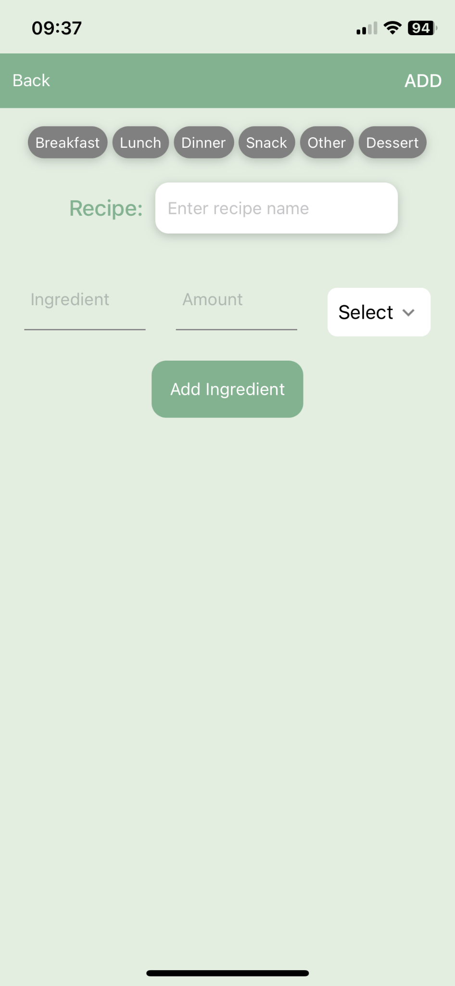
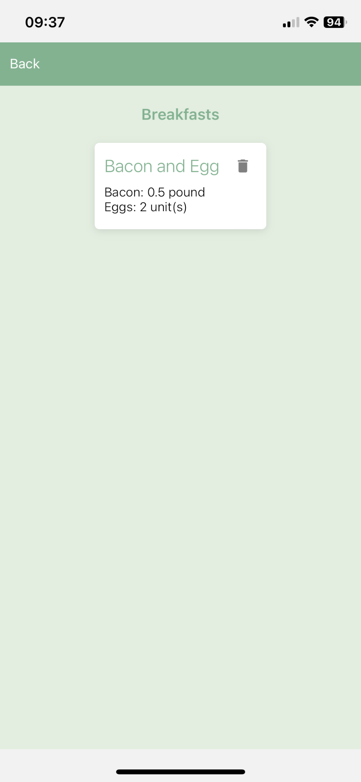

Slide 18


Slide 19
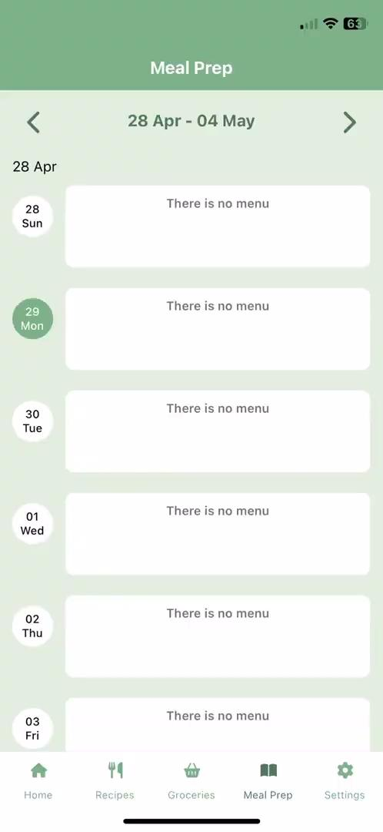
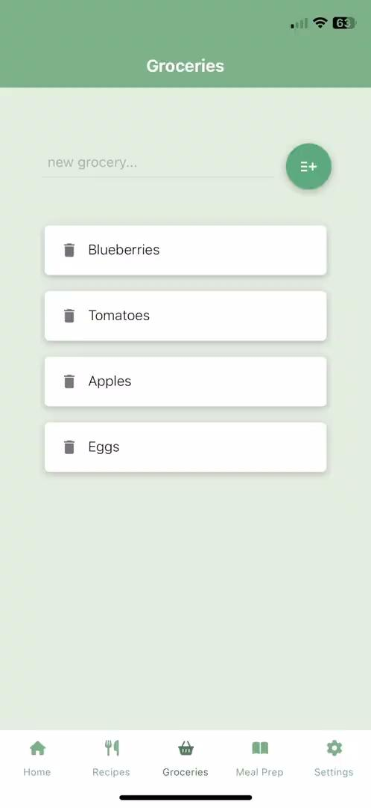

Slide 20
Coming soon…
Link Recipes to Grocery List
Adding Recipe to Meal Plan
Login and Authentication
Backend Database & Data Storage

Slide 21
Project Pro Tips: Take-aways
Advice
Start early
Stay on track!
Use your team and your resources
Ask for help/advice
Learn React & React Native before development
Youtube tutorials really help to get the hang of things!

Slide 22
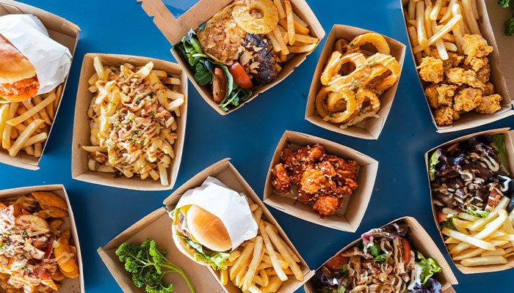
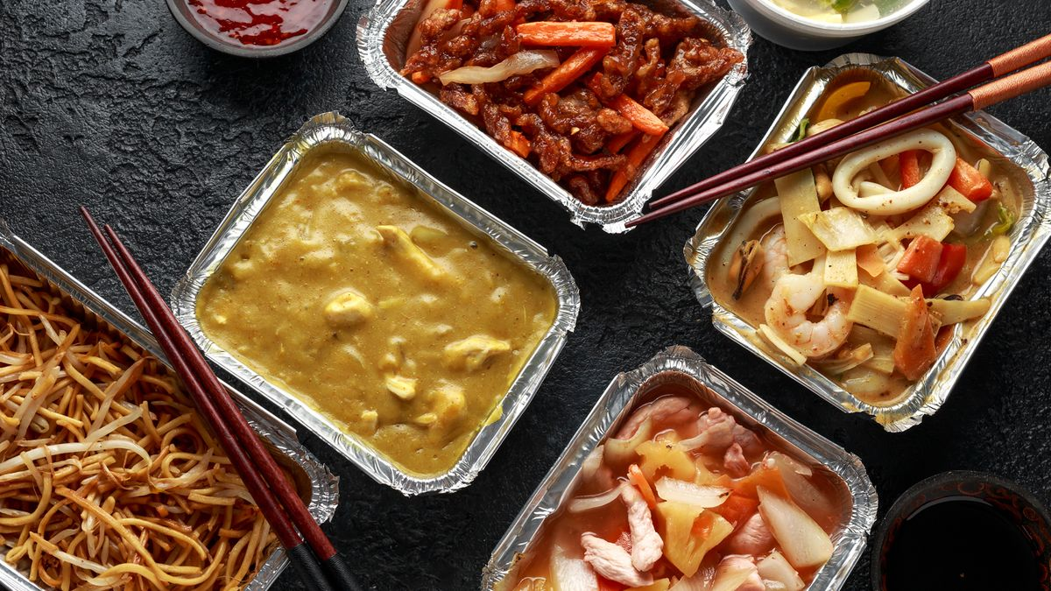
Questions To Go?

